Slide 1
How to use the cards
Pick a card and think about the following:
Who might experience this barrier? Consider specific groups such as prisoners, older adults, and other user characteristics.
Why might the barrier arise? Get to the root causes by asking “Why?” five times
What impacts does the barrier have on users? Make a list, e.g. less able to use the service correctly, at all, or without assistance
What impacts does the barrier have on your organisation? Make a list, e.g. Increased demand for support, failure demand, Loss of trust or reputational damage, Non-compliance with accessibility laws (e.g WCAG)
When does the barrier arise? Is it tied to a specific task? How often does it happen? Is it temporary, permanent, or situational?
Do the barriers interlink? Look for patterns or connections between barriers that could compound challenges for users.
How might barriers be reduced or removed? List the changes needed and what is required to make them
Universal barriers Discussion cards
(version without prompts)
Use these cards to explore the barriers users face through a more inclusive lens, going beyond the traditional focus on digital exclusion and accessibility challenges.
Generate discussions, build empathy and inspire questions and hypotheses.
Each card also shows how the barrier aligns with the COM-B Behavioural Model.
COM-B model

Slide 2


Emotional state
e.g. If someone does not feel emotionally strong enough to take on a task, they are more likely to be excluded. For example, they may be exhausted from round-the-clock caring duties, or highly worried about money and fearful of repercussions
Particularly consider links to - time, self-confidence, trust, enthusiasm, comprehension
Self confidence
e.g. If someone lacks confidence in their ability to understand a process, complete a task and deal with arising situations, they are more likely to be excluded (even if they could technically do it if they tried)
Particularly consider links to - trust, emotional state
COM-B model
Motivation
COM-B model
Motivation

Slide 3
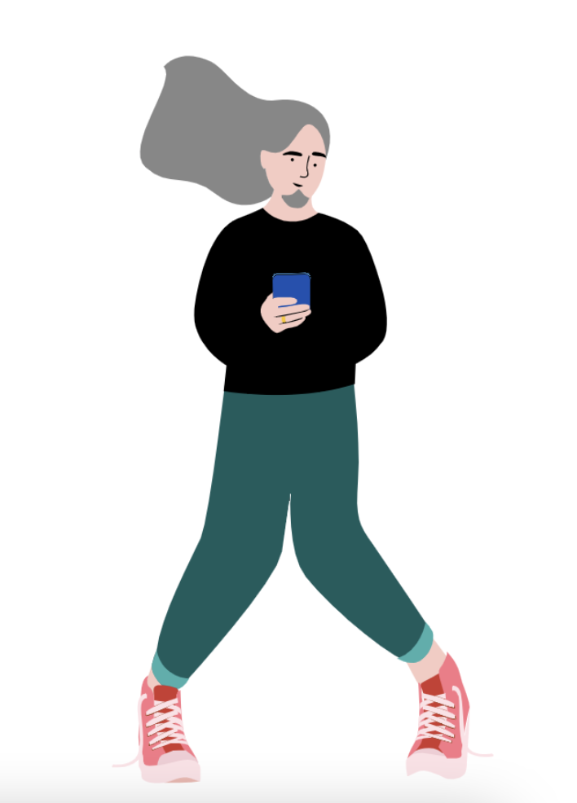

Trust
Access
e.g If someone does not trust the people, organisations, devices or technologies they are being required to interact with then they are more likely to be excluded.
Particularly consider links to - confidence,enthusiasm
e.g. If people do not know about or cannot find something, for example, an opportunity, an office, or support, then they are excluded from it.
Particularly consider links to - finance, time, interface skills, trust and enthusiasm
COM-B model
Motivation
COM-B model
Opportunity

Slide 4


Enthusiasm
e.g. If someone is not motivated to do something then they are unlikely to do it, and will be excluded. For example, responding to communications, filling out a complex form, attending an appointment or following advice
Particularly consider links to - time, self- confidence, trust, interface/interaction skills
Time
e.g. If someone lacks the time required to, for example, gather information, fill out forms, travel to a meeting, or wait on the phone, they may be excluded.
Particularly consider links to - enthusiasm, self-confidence
COM-B model
Motivation
COM-B model
Opportunity

Slide 5


Finance
e.g. If someone is worried about meeting the cost of doing something, including costs that are not yet clear, they are more likely to be excluded.
Particularly consider links to - self-confidence, trust, access
Evidence
e.g. If someone is required to provide evidence (bank statements, proof of address, a passport, other photo ID) that they don’t have or cannot easily access, they are more likely to be excluded.
Particularly consider links to - finance, time, interface skills, trust and enthusiasm
COM-B model
Opportunity
COM-B model
Opportunity

Slide 6


Interface and interaction skills
e.g. Conversing (talking and listening) in person or over the phone or on a video call, or using a device like a computer, smartphone, camera, printer or pen.
Particularly consider links to - self-confidence, trust
Comprehension skills
e.g. If someone struggles to understand important information, whether it is spoken to them or written on a screen or paper, they are more likely to be excluded.
Particularly consider links to - self-confidence, trust, interface and interaction skills
COM-B model
Motivation
COM-B model
Motivation

Slide 7

Awareness
e.g. If people do not know about or cannot find something, for example, an opportunity, an office, or support, then they are excluded from it.
Particularly consider links to - time, self-confidence, trust
COM-B model
Opportunity

Slide 8
How to use the cards
Pick a card and think about the following:
Who might experience this barrier? Consider specific groups such as prisoners, older adults, and other user characteristics.
Why might the barrier arise? Get to the root causes by asking “Why?” five times
What impacts does the barrier have on users? Make a list, e.g. less able to use the service correctly, at all, or without assistance
What impacts does the barrier have on your organisation? Make a list, e.g. Increased demand for support, failure demand, Loss of trust or reputational damage, Non-compliance with accessibility laws (e.g WCAG)
When does the barrier arise? Is it tied to a specific task? How often does it happen? Is it temporary, permanent, or situational?
Do the barriers interlink? Look for patterns or connections between barriers that could compound challenges for users.
How might barriers be reduced or removed? List the changes needed and what is required to make them
Universal barriers Discussion cards
(version with prompts)
Use these cards to explore the barriers users face through a more inclusive lens, going beyond the traditional focus on digital exclusion and accessibility challenges.
Generate discussions, build empathy and inspire questions and hypotheses.
Each card also shows how the barrier aligns with the COM-B Behavioural Model.
COM-B model

Slide 9
Some prompts to think about:
Assistive screen readers often fail to convey critical information effectively if content lacks clear headings, landmarks, or alt text.
Complex or demanding services can exhaust users with physical or cognitive disabilities. Sustained effort, quick responses, or multitasking can be overwhelming, especially for those working at different paces or with lower confidence.
Remembering long numbers, performing calculations, or processing sequences of information can be especially difficult for users with dyscalculia, dyslexia, or dyspraxia, leading to errors or frustration. This may also be true for users under stress or fearing making a mistake.
Users for whom English is not their first language may struggle to navigate services without translation options or multilingual support. Automated assistants that don’t work well can lead to misunderstandings or ineffective support.
Around 8.5 million people lack the digital skills needed for daily life. This has been exacerbated by the COVID-19 pandemic, which saw many community support organisations face closure.
Interface and interaction skills
For example, conversing (talking and listening) in person or over the phone or on a video call, or using a device like a computer, smartphone, camera, printer or pen.
Barrier may link with others - Self-confidence, Trust
Barrier may link with - Self-confidence, Trust
COM-B model
Capability
Notes:
Are our pages structured to support assistive technologies?
How can we reduce cognitive load and simplify service processes?
Are we providing adequate support for users with numerical or memory difficulties?
Do our services include translations and culturally sensitive designs to support non-native English speakers?
How can we address digital exclusion and support users who lack confidence or access to online services?

Slide 10
Some prompts to think about:
Without clear and effective signposting, users might struggle to find something then need, particularly if they don’t already know it exists
If people don’t know where to seek help they may feel lost and unsupported, and they might give up
How to identify awareness barriers:
Analyse user feedback to uncover instances where people didn’t know where to find support.
Collaborate with voluntary sector organisations to understand gaps and trends in a community’s awareness.
Use tools like the CItizens Advice Trends dashboard, Good Things Foundation reports, social media discussions, and online forums to gather insights.
Awareness
If people do not know about something (for example a service, an opportunity, an office, or support) then they are excluded from it.
Barrier may link with others - Time, Access Self-confidence, Trust
COM-B model
Opportunity
Notes:
How do users become aware of your service?
How do they find it, and how can they access it without prior familiarity?

Slide 11
Some prompts to think about:
Language that assumes users have prior knowledge of your service excludes those who don’t. This could include technical jargon, complex terms, or unclear instructions.
More complex language (on websites, letters or phone calls) may exclude users with lower levels of language or literacy skills.
Language that isn’t plain, clear and following established style guides, can be hard for people to understand.
Users may end up ignoring or being unable to understand critical messages, resulting in consequences like debt, missed payments, or loss of income.
Remembering dates, times, or appointments can be overwhelming.
Comprehension skills
If someone struggles to understand important information, whether it is spoken to them or written on a screen or paper, they are more likely to be excluded.
Barrier may link with - Self-confidence, Trust, Interface and interaction skills
COM-B model
Capability

Slide 12
Resilience
If someone does not feel emotionally or physically strong enough to take on a task, they are more likely to be excluded. For example, they may be exhausted from round-the-clock caring duties, or highly worried about money.
Barrier may link with - Time, Self-confidence, Trust, Enthusiasm and Comprehension
Some prompts to think about:
Poor mental health can impair focus and concentration, making it harder to process information or evaluate multiple options, and more likely for mistakes to occur. This is more likely with detailed or complicated instructions.
1 in 4 people in England experience a mental health issue each year, and 3 in 4 (75%) of people with mental health conditions have difficulty using common communication channels, such as telephone calls, face-to-face interactions, or handling physical mail.
Remembering critical details like payment deadlines, tax obligations, or login credentials can be particularly challenging.
Users may feel insecure about their actions and anxious about making mistakes.
Users may lack the energy to do what’s being asked of them, particularly those managing chronic illnesses or disabilities.
COM-B model
Capability

Slide 13
Some prompts to think about:
Users in more remote or disconnected places may face long or costly journeys to access the internet, appointments or support services.
Limited public transport options often lead to frustrations such as, “I can’t afford to waste time and money traveling just for a short session on a public computer.”
Webchat can be time-consuming, especially for people who can’t type very fast.
The frustration of lengthy efforts may push users to switch to phone support instead.
Long wait times for help may deter users from seeking the help they need.
Users may turn to voluntary and community sector (VCS) organisations for support instead, putting additional strain on these services.
Time
If someone lacks the time required to, for example, gather information, fill out forms, travel to a meeting, or wait on the phone, they may be excluded.
Barrier may link with others - Enthusiasm, Self-confidence
COM-B model
Opportunity

Slide 14
Some prompts to think about:
Costs associated with phone calls or internet access can put people off.
Using data on a mobile phone may be too costly for some people.
In rural communities, accessing the internet or support often requires travel, which can be expensive in itself and involve lost earnings.
Limited public transport options mean users frequently express concerns like, “I can’t afford to waste time and money traveling just for limited access to a public computer.”
Events like recession and pandemics worsen financial strains for many. Within the first three weeks of lockdown for COVID-19, 7 million households experienced a significant loss of income, and 3.1 million households fell into serious financial difficulty.
Finance
If someone is worried about meeting the cost of doing something, including costs that are not yet clear, they are more likely to be excluded.
Barrier may link with - Self-confidence, Trust, Access
COM-B model
Opportunity

Slide 15
Access
If people do not know about or cannot find something, for example, an opportunity, an office, or support, then they are excluded from it.
Barrier may link with - Finance, Time, Interface Skills, Trust and Enthusiasm
Some prompts to think about:
An estimated 7% of UK households do not have internet access at home
For those who rely on shared or outdated devices, completing tasks can be stressful and time-consuming.
Many users, particularly in rural areas, continue to face issues with broadband availability, speed, and reliability.
Users may struggle to find clear signposting to support services, such as telephone helplines or in-person assistance, leaving them without adequate help when needed.
If a task requires users to access assistive technology, and they struggle to do so, they are more likely to be excluded
COM-B model
Opportunity

Slide 16
Some prompts to think about:
Users may not have sufficient access to the necessary documents, for example passports, financial records, or credit histories
This is especially likely for people with thin credit files, no or often-changing address, or limited financial backgrounds.
Even users with higher digital skills can lack an email address to which they have reliable and confident access
Lacking a stable address can be linked to other challenges affecting engagement with and use of services.
Many services rely on users recalling specific login details (such as URN or account numbers), which may be difficult for some, particularly those with memory challenges or those who don’t have regular access to their account information.
Evidence
If someone is required to provide evidence they do not have or cannot easily access, they are more likely to be excluded. For example, bank statements, proof of address, a passport or other photo ID.
Barrier may link with finance, time, interface skills, trust and enthusiasm
COM-B model
Opportunity

Slide 17
Some prompts to think about:
Users may become overwhelmed and avoid doing something if they aren’t confident that they can do it. This is more likely for complex or hard-to-navigate tasks.
A person’s understanding of their tax obligations and their confidence in managing them plays a crucial role in whether they engage with the service.
Users may be less confident with unfamiliar tasks or services they don’t use or engage with often, especially complex or particularly significant tasks.
Lack of confidence can cause users to second-guess their ability and make them more likely to ask others to complete a task for them. Verbal confirmation can help reduce anxiety.
Users can feel anxious about misinterpreting instructions or guidance, especially for critical tasks like taxes.
Self confidence
If someone lacks confidence in their ability to understand a process, complete a task and deal with arising situations, they are more likely to be excluded (even if they could technically do it if they tried)
Barrier may link to - Trust, Emotional state
COM-B model
Motivation

Slide 18

Some prompts to think about:
Lack of trust in a service, or the organisation or people running it, can lead to fear, frustration and avoidance
Users may lack trust in security and privacy, including how their personal information is handled and shared. They may believe the internet to be inherently unsafe or unreliable.
Inconsistent, unreliable and hard to navigate user journeys, including dead ends and vicious circles, can reduce trust.
Users may lose trust if they are uncertain about what to expect during a process, especially if there are no updates or clear communication about the status of their request.
Trust may vary by communication channel:
Letters: Often seen as more official and easier to validate, letters may be viewed as more trustworthy.
Phone: Some users may find phone communication more reassuring due to the human interaction, or less so if they aren’t confident about who they’re talking to
Emails and text messages: These may be less trusted by some users, especially if they are concerned about phishing or scams.
Trust
If someone does not trust the people, organisations, devices or technologies they are being required to interact with then they are more likely to be excluded.
Barrier may link with - Confidence, Enthusiasm
COM-B model
Motivation

Slide 19
Some prompts to think about:
A lack of motivation or enthusiasm can lead users to avoid engaging with services or support.
Over one-third of individuals who are offline say that the internet “doesn’t interest them”. 48% say that nothing could motivate them to get online. This lack of interest can make it less likely that they will engage with online services.
Some users may only need to access certain services occasionally. Government research shows that infrequent interaction with services reduces motivation to develop digital skills or go online.
Prior negative experiences with the internet or a service can discourage users from trying again or exploring new options. This past frustration can reduce their enthusiasm for engagement.
For some, the internet is not a priority or necessity, especially if they’ve lived without it for most of their lives. Without a clear need or sense of urgency, these users may have little motivation to develop online skills.
Enthusiasm
If someone is not motivated to do something then they are unlikely to do it, and will be excluded. For example, responding to communications, filling out a complex form, attending an appointment or following advice
Barrier may link with - Time, Self- confidence, Trust, Interface/interaction skills
COM-B model
Motivation
Notes:
What can we do to change this behaviour ?

Slide 20
Universal Barriers
Game
Objectives
Help stakeholders, policy professionals and service teams identify and understand the various barriers users might face when interacting with a service or policy
Encourage a broader and more actionable perspective on inclusivity.

Slide 21
Setup
Ask participants to form into groups of 2 or 3 people.
Designate half the groups as type 1 and half as type 2.
Give the type 1 groups the barrier cards without prompts.
Give the type 2 groups the barrier cards with prompts.
Activity - identifying barriers Type 1 groups
Choose a task, service or user journey
Write down all the smaller tasks required to complete it, from the very start to the end
Based on your own experiences and knowledge, write down
What barriers you expect
What impact they would have
When they occur
Why they occur
How they might be resolved

Slide 22
Activity - identifying barriers Type 2 groups
Choose a task, service or user journey
Write down all the smaller tasks required to complete it, from the very start to the end
Using the universal barriers cards and prompts, write down
What barriers you expect
What impact they would have
When they occur
Why they occur
How they might be resolved
Activity - review All groups together
Ask type 1 groups to share the barriers they identified.
Ask type 2 groups to share the barriers they identified.
Compare the range of barriers from each group and discuss any differences.
Discuss the value from identifying broader barriers, including the ability to carry out higher quality research and deliver outcomes.

